Slide 1
Runtime Review
Runtime Review
cs112

Slide 2

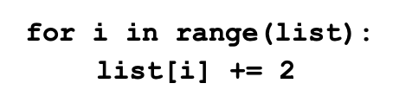
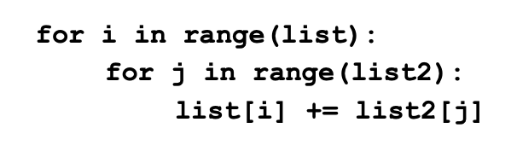
What is Runtime?
Runtime (or Execution Time) is the time it takes a computer to execute a program
Runtime Examples (Worst Case / Big-O)
Constant
Linear
Quadratic

Slide 3
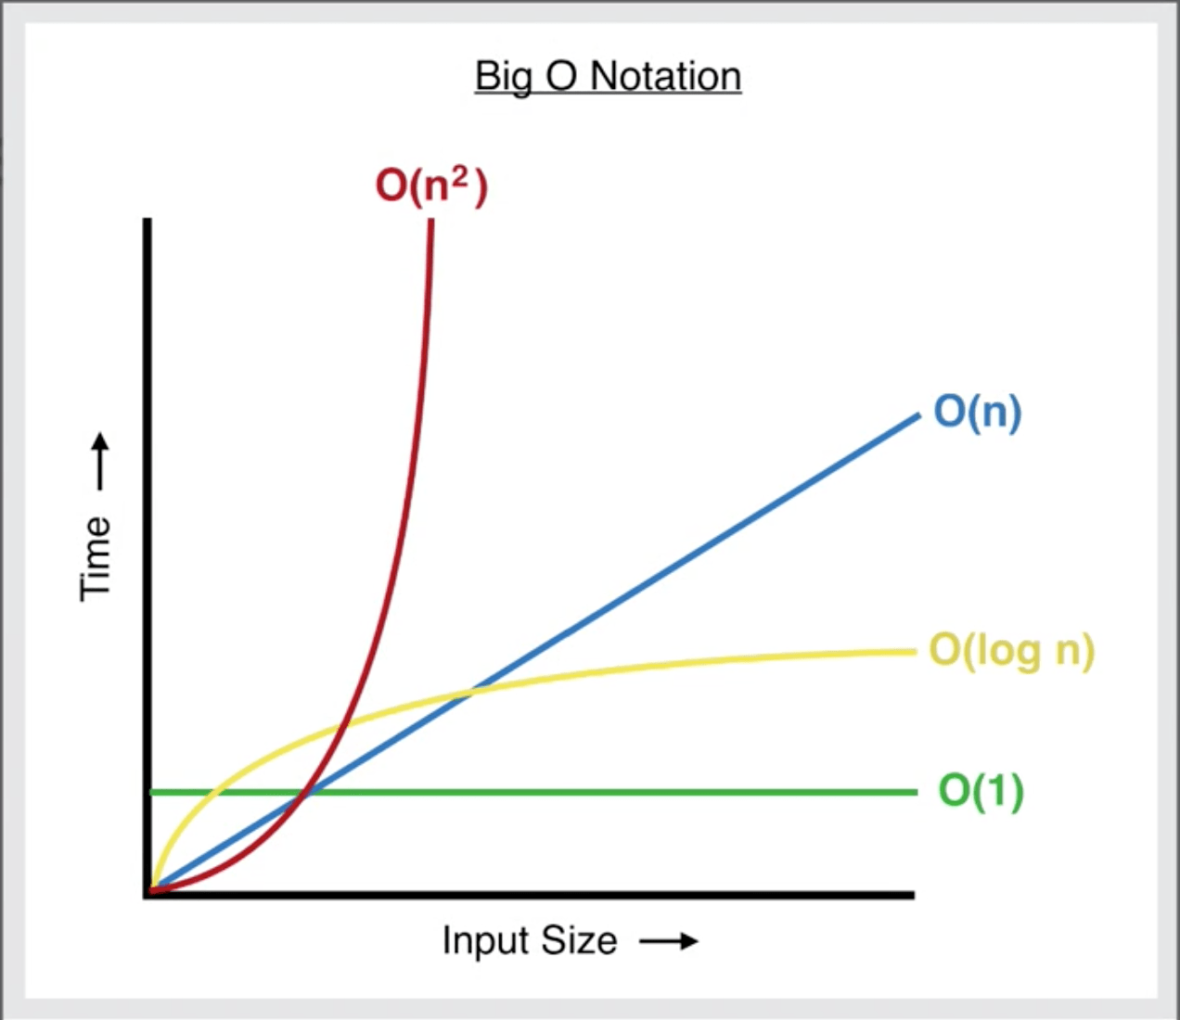
Big-O Notation
Big-O: Finding an asymptotic upper bound of a program
Used to measure the performance of an algorithm
Gauges the time complexity of an algorithm

Slide 4
Runtime Example Practice
What is the runtime of the code below?
1.
nums = [5,3,4,2,4]
for i in range(len(nums)):
for j in range(len(nums)):
nums[i] *= j
return nums
2.
nums_set = set()
nums_set.add(‘fruit’)
return nums_set
Notes:
Answers: 1. O(n^2), 2.O(1)

Slide 5
Why is Runtime Important?
Want clean, efficient code!
High runtime → Inefficient performance
ex: Dealing with large data files
May take a long time to load/manipulate data :(
Sometimes the inefficient approach is the wrong
solution (always try to optimize!)
ex: Use a set instead of a list (if possible)

Slide 6
Lab Assignment
Goal: See the differences in runtime performances between best and worst case scenarios through plotted graphs
Task: Fill in the worst_case_input()and the generate_graphs() functions
Follow the comments/tips provided in the file to fill in the methods

